Slide 1



Concrete Strength Prediction
Keng Ming Cheng
University of California, Los Angeles (UCLA)
Contact: kengming_cheng@outlook.com
Physics of AmoRphous and
Inorganic Solids Laboratory

Slide 2
Glass Data Extraction

Slide 3
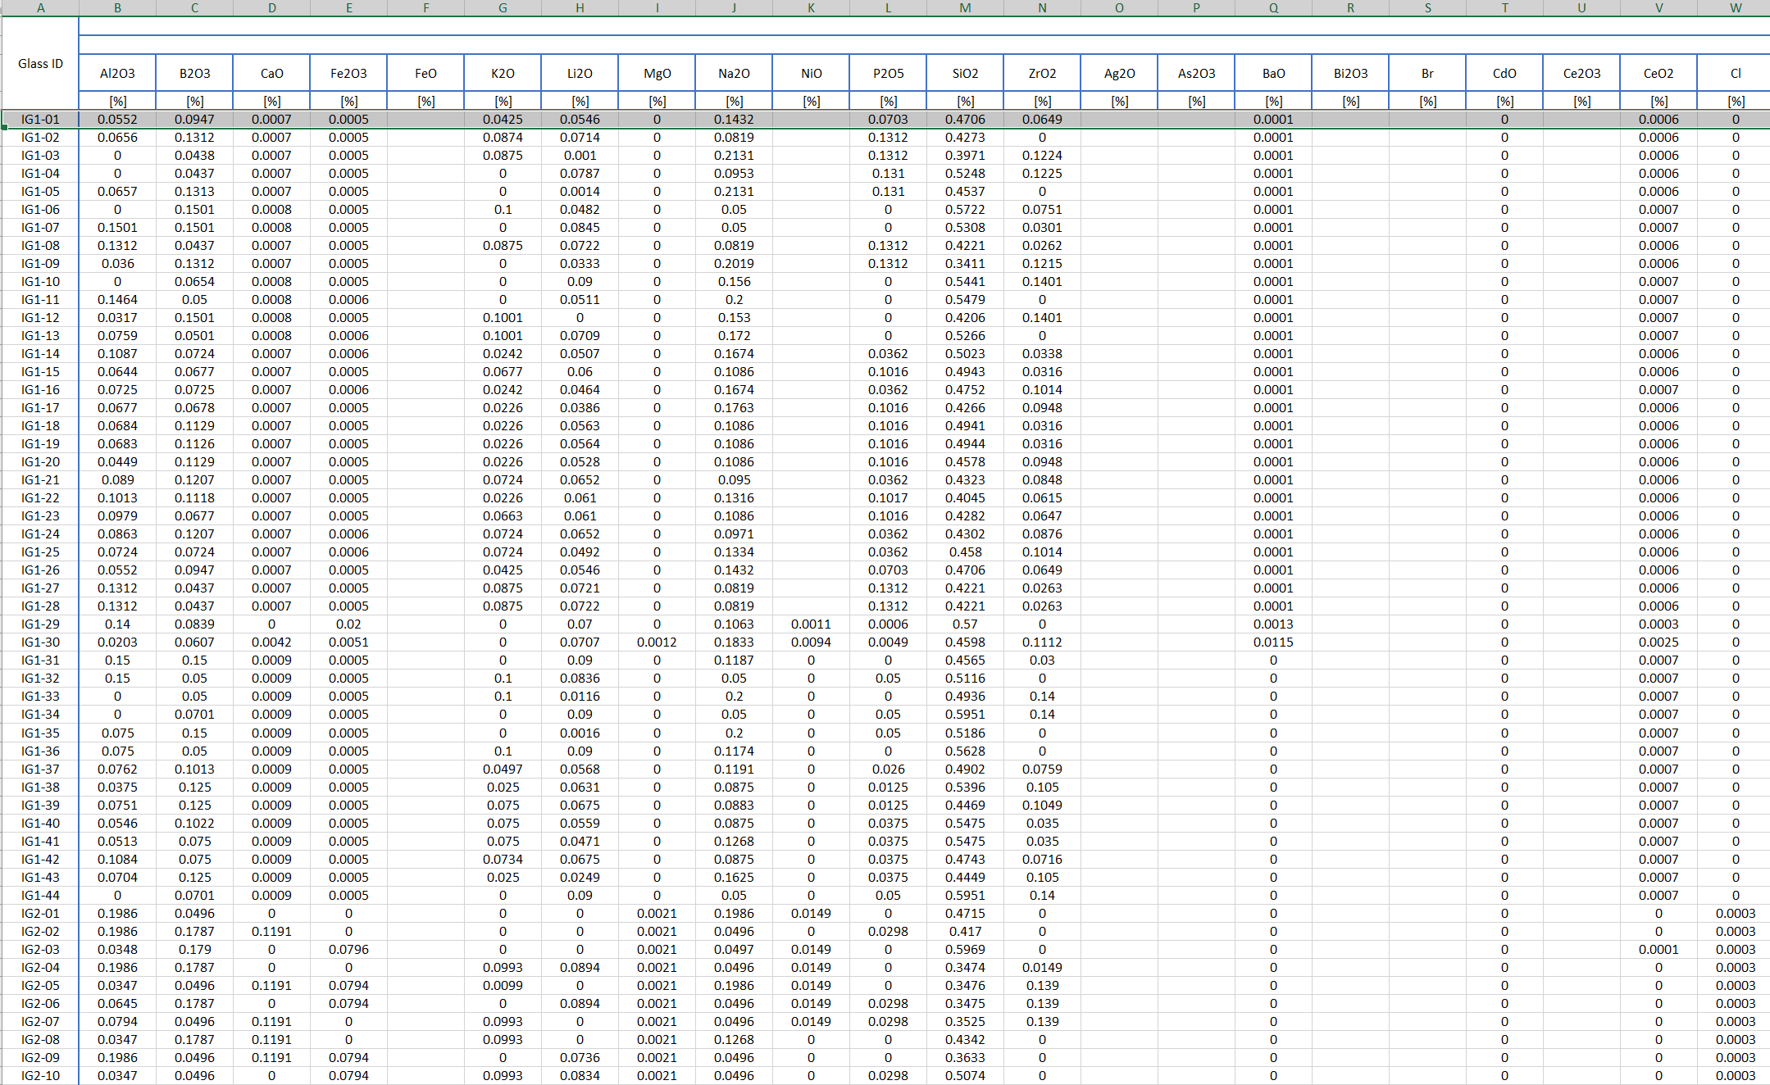
Results
Glass Data Extraction

Slide 4
Searching Optimal Value Based on Trained model

Slide 5
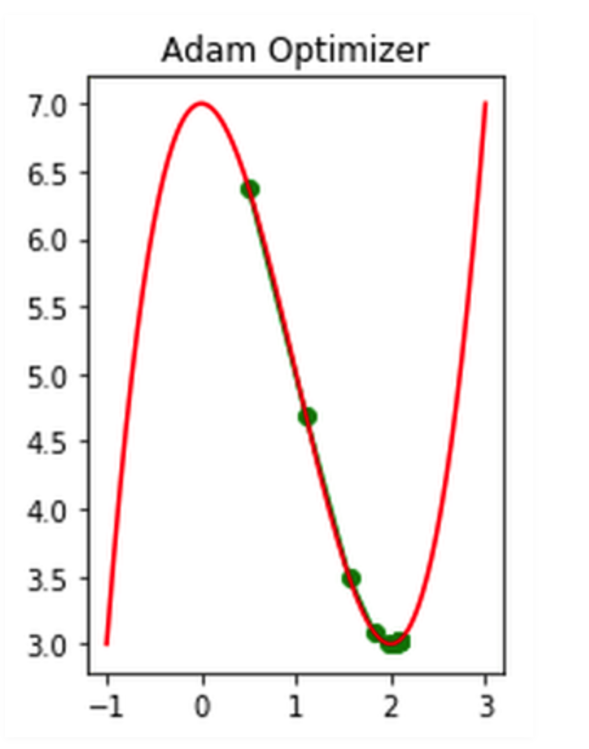
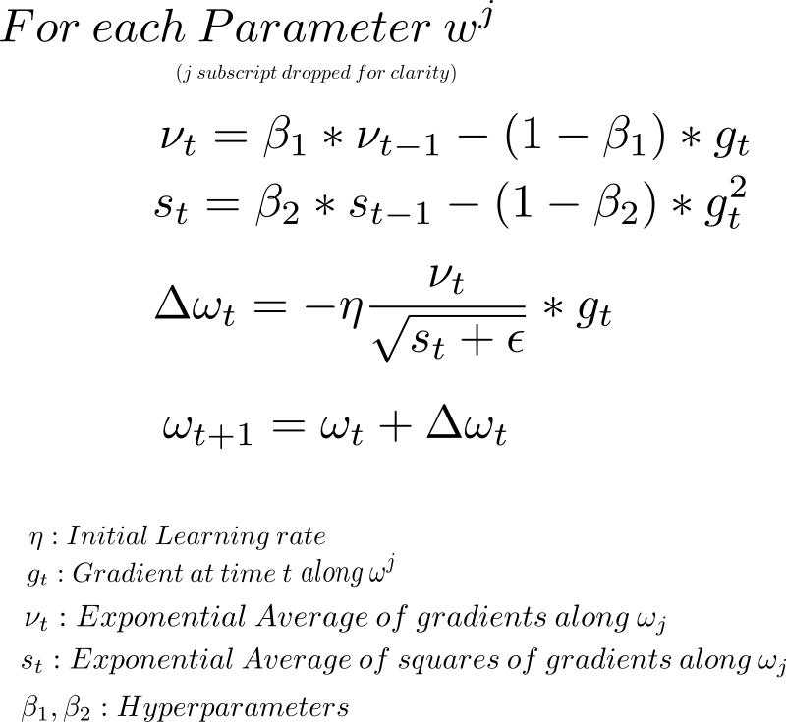
Results
Searching Optimal Value
Using optimizer to approach the global maximum of strength per cost
cost = Sum of input features
Loss = - (Predicted strength) / (Sum of input features)
Use Adam optimizer to get minimum regarding to Loss
opt = tf.keras.optimizers.Adam(learning_rate=0.01)
loss_fn = lambda: tf.constant(-1.0) * (nn_model(var1)*target_scaler.scale_[0]+target_scaler.mean_[0]) * 0.00689476 / tf.reduce_sum(var1*input_scaler.scale_+input_scaler.mean_)
for _ in range(500):
opt.minimize(loss_fn, [var1])

Slide 6
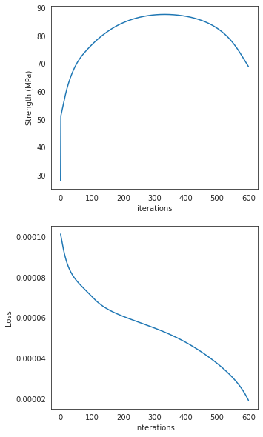
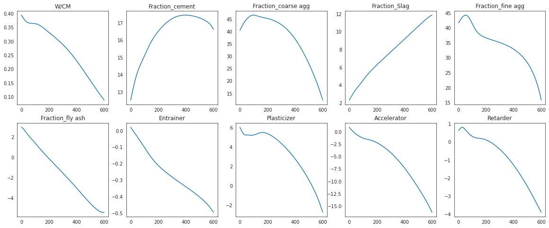
Results
Searching Optimal Value
cost = Sum of input features
Loss = - (Predicted strength) / (Sum of input features)
Use Adam optimizer to get minimum regarding to Loss

Slide 7
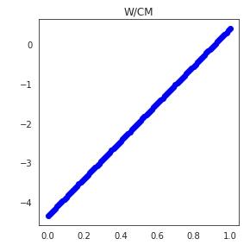
Results
Plotting Interpolating Results
Optimized values by Adam
Interpolating data from minimum to optimized value as a path for examining gradients
Plotting the gradients changes along the path of optimized values
To verify whether the calculated values are the best composition for performance per cost
Minimum values for the dataset

Slide 8
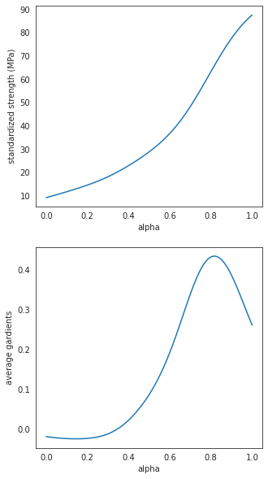
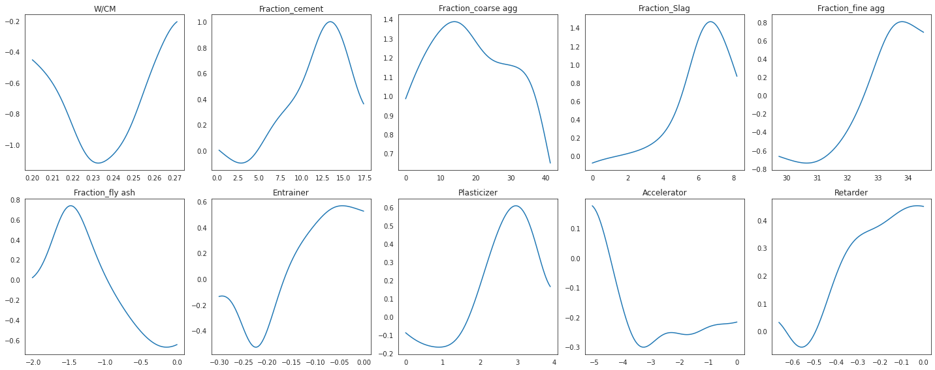
Results
Searching Optimal Value

Slide 9

Notes:
Thank sponsors

Slide 10
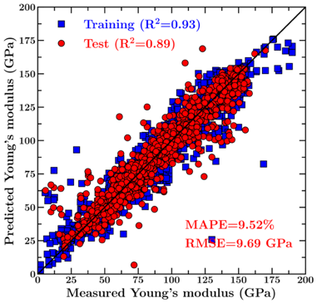
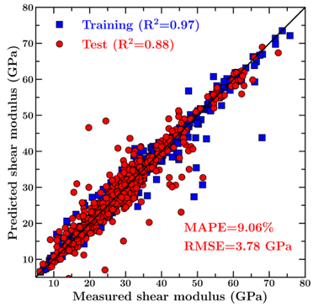
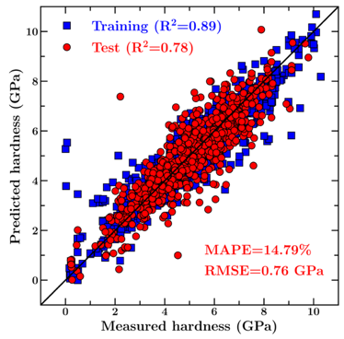
Results
Prediction of Concrete Mechanical Properties
Young’s modulus
Shear modulus
Hardness
> Our model offers a very good prediction of the mechanical properties of test set glasses (which are kept invisible to the model during its training).

Slide 11
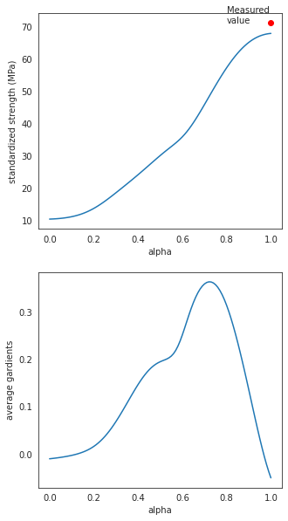
Results
Searching Optimal Value
Integrated Gradients
alpha = 0 represent the values of baseline
alpha = 1 represent the values closed to optimal values
alpha =0 → alpha = 1 searching the path where the optimal values may exist
def compute_gradients(datas,target_class_idx = 0):
with tf.GradientTape() as tape:
tape.watch(datas)
logit = nn_model(datas)
probs = logit
return tape.gradient(probs, datas)
def integral_approximation(gradients):
# riemann_trapezoidal
grads = (gradients[:-1] + gradients[1:]) / tf.constant(2.0)
integrated_gradients = tf.math.reduce_mean(grads, axis=0)
return integrated_gradients
def gradients_for_regression(baseline, data,m_steps=100,batch_size=32,show_measured_data=True):
alphas = tf.linspace(start=0.0, stop=1.0, num=m_steps+1)
interpolated_data = interpolate_datas(baseline, data, alphas)
path_gradients = compute_gradients(datas = interpolated_data)
prediction = nn_model(interpolated_data)

